Slide 1
Randomized Algorithms CS648
Lecture 25
Probabilistic Method
(part 1)

Slide 2


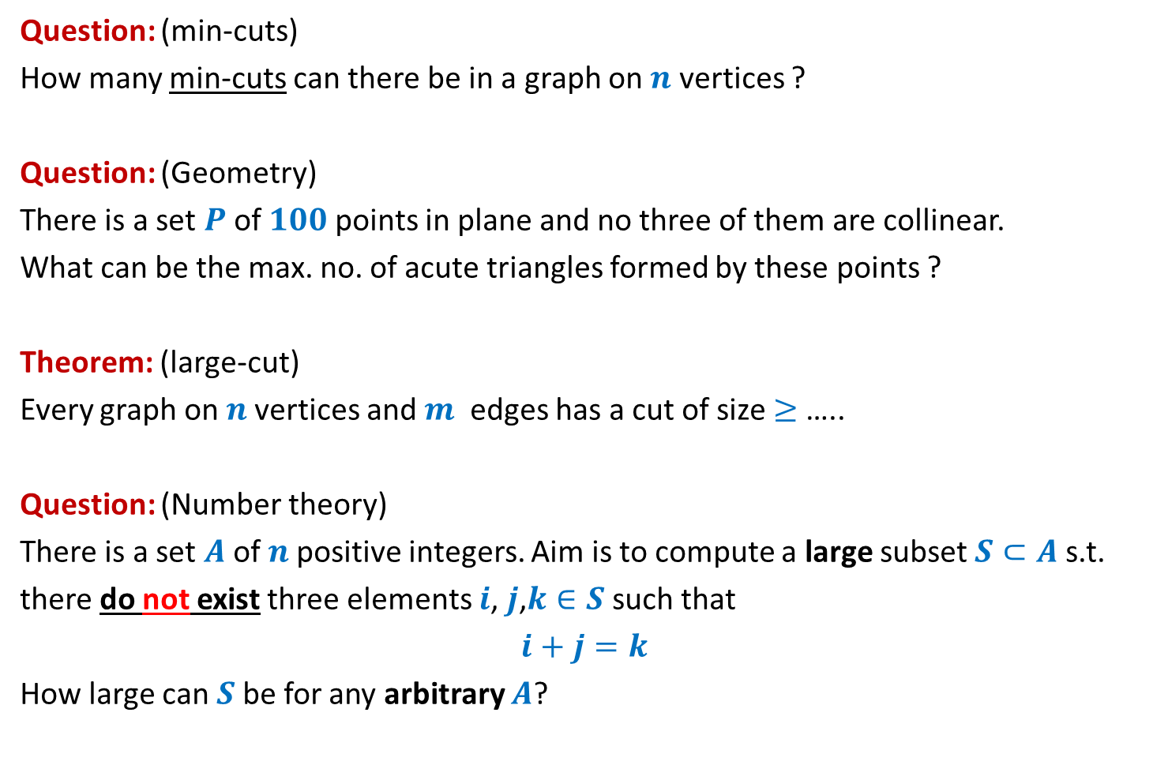


Questions from Discrete Mathematics
Question: (min-cuts)
How many min-cuts can there be in a graph on $n$ vertices ?
Question: (Geometry)
There is a set $P$of $100$points in plane and no three of them are collinear.
What can be the max. no. of acute triangles formed by these points ?
Theorem: (large-cut)
Every graph on $n$vertices and $m$ edges has a cut of size $≥$ …..
Question: (Number theory)
There is a set $A$of $n$positive integers. Aim is to compute a large subset $S⊂A$s.t.
there do not exist three elements $i$, $j$,$k∈S$ such that
$i+j=k$
How large can $S$be for any arbitrary $A$?
$$O(n^{2})$$
At most $70\%$
$$m/2$$
At least $n/3$

Slide 3
Probabilistic methods

Slide 4
Probabilistic methods
Methods that use
Probability theory or
Randomized algorithm
to prove deterministic combinatorial results

Slide 5
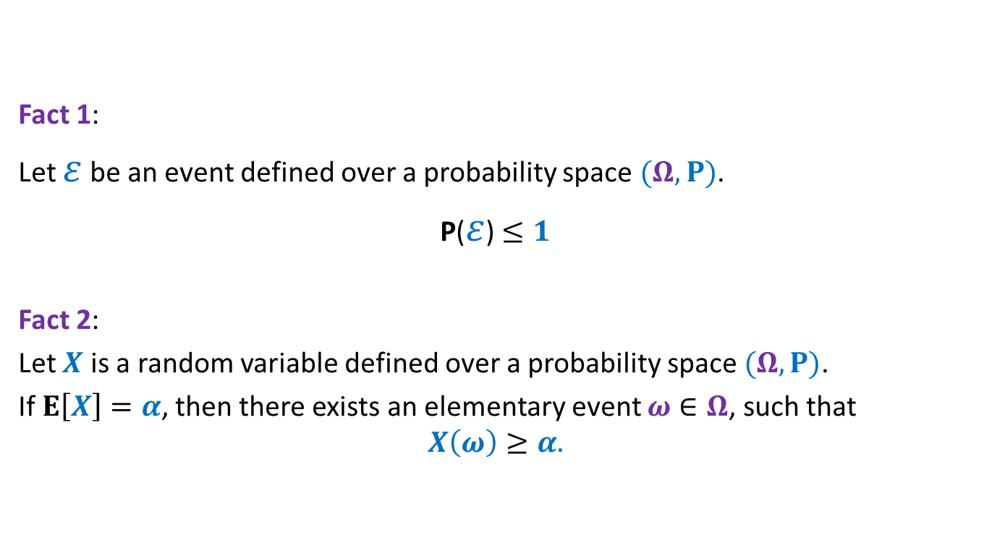
Elementary facts from probability theory
Fact 1:
Let $ε$ be an event defined over a probability space $(Ω,P)$.
P($ε$)$≤1$
Fact 2:
Let $X$ is a random variable defined over a probability space $(Ω,P)$.
If $E\left[X\right]=α$, then there exists an elementary event $ω∈Ω$, such that
$$X\left(ω\right)≥α.$$

Slide 6
problem 1 How Many min CUTs ?

Slide 7


Min-Cut
$G=(V,E)$: undirected connected graph
Definition (cut):
A subset $C⊆E$whose removal disconnects the graph.
Definition (min-cut): A cut of smallest size.
Question: How many cuts can there be in a graph?
Question: How many min-cuts can there be in a graph?
$$\frac{2^{n}−2}{2}$$

Slide 8
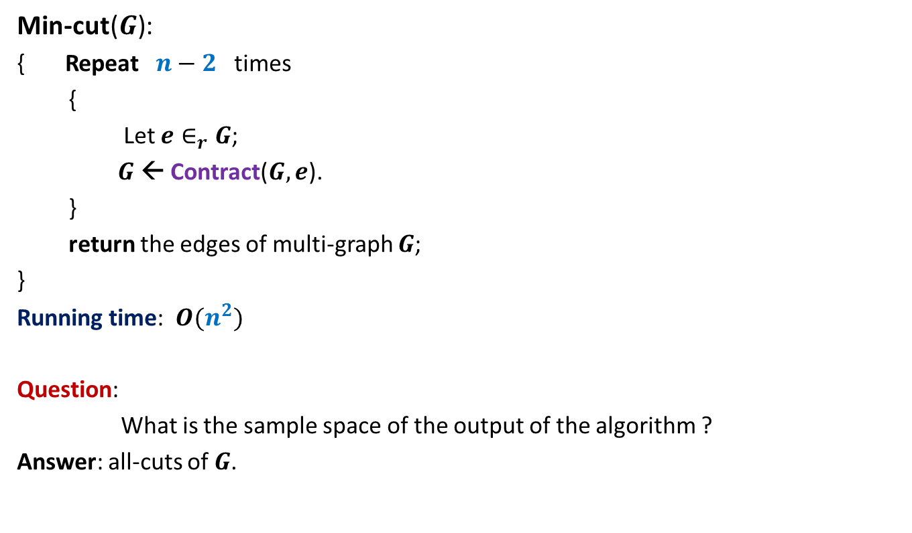
Algorithm for min-cut
Min-cut($G$):
{ Repeat $n−2$ times
{
Let $e∈_{r}G$;
$G$ ← Contract($G,e$).
}
return the edges of multi-graph $G$;
}
Running time: $O(n^{2})$
Question:
What is the sample space of the output of the algorithm ?
Answer: all-cuts of $G$.

Slide 9
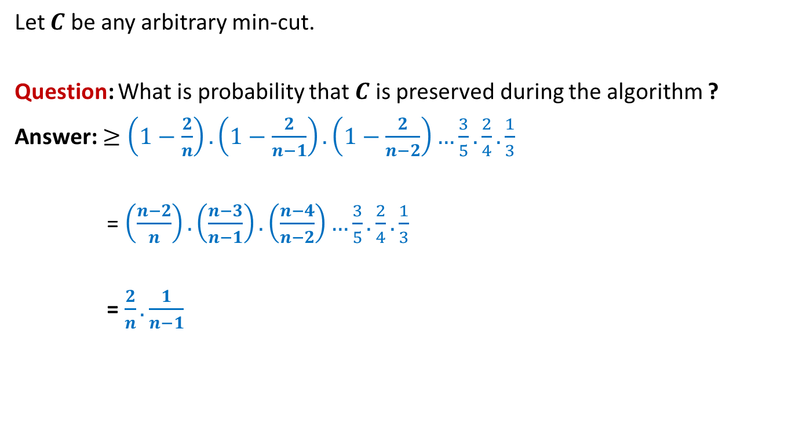
Analysis of Algorithm for min-cut
Let $C$ be any arbitrary min-cut.
Question: What is probability that $C$ is preserved during the algorithm ?
Answer: $≥\left(1−\frac{2}{n}\right).\left(1−\frac{2}{n−1}\right).\left(1−\frac{2}{n−2}\right)…\frac{3}{5}.\frac{2}{4}.\frac{1}{3}$
= $\left(\frac{n−2}{n}\right).\left(\frac{n−3}{n−1}\right).\left(\frac{n−4}{n−2}\right)…\frac{3}{5}.\frac{2}{4}.\frac{1}{3}$
= $\frac{2}{n}.\frac{1}{n−1}$

Slide 10



Number of min-cuts
Let there be $k$ min-cuts in $G$.
Let these min-cuts be $C_{1},C_{2},…,C_{k}$.
Define event $ℰ_{i}$ : “output of the algorithm Min-cut($G$) is $C_{i}$”.
P($ℰ_{i}$)$≥ ?$
P($∪_{i}ℰ_{i}$) $? \text{P}\text{(}ℰ_{1}\text{)}\text{+}\text{P}\text{(}ℰ_{2}\text{)}\text{+...}\text{P}\text{(}ℰ_{k}\text{)}$
$≥ k\frac{2}{n(n−1)}$
Surely P($∪_{i}ℰ_{i}$) $≤1$
➔$1≥k\frac{2}{n(n−1)}$
➔$k≤ \frac{n(n−1)}{2}$
$$\frac{2}{n(n−1)}$$
$$=$$
At the end of the algorithm
Disjoint events
…
we are left with a multigraph with 2 vertices. Each of these vertices corresponds to a unique subset of vertices. So the corresponding cut is uniquely defined.

Slide 11
problem 2 How many Acute Triangles ?

Slide 12
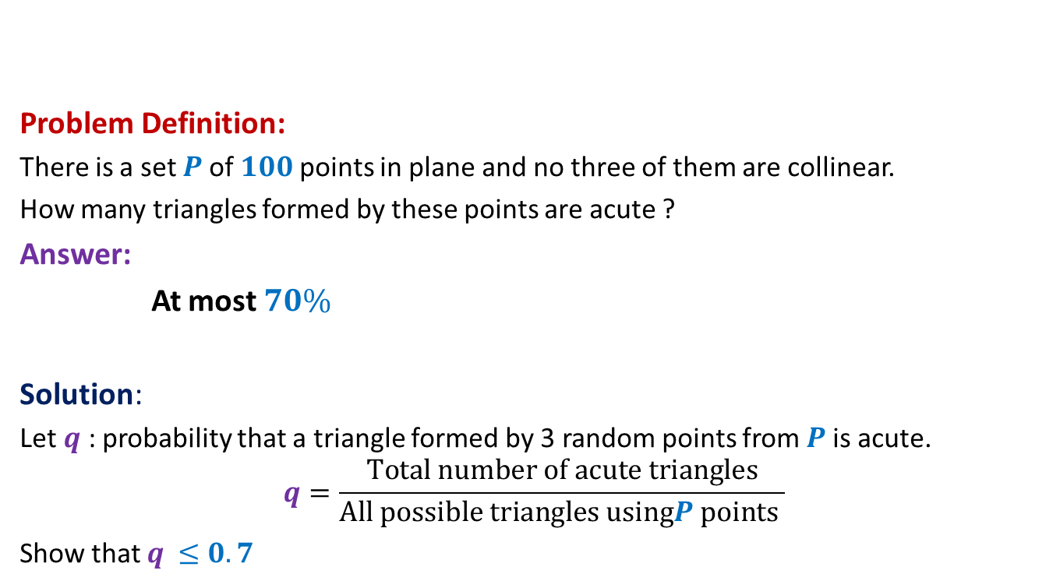
How many acute triangles
Problem Definition:
There is a set $P$of $100$points in plane and no three of them are collinear.
How many triangles formed by these points are acute ?
Answer:
At most $70\%$
Solution:
Let $q$ : probability that a triangle formed by 3 random points from $P$is acute.
$$q=\frac{Total number of acute triangles}{All possible triangles usingP points }$$
Show that $q$ $≤0.7$

Slide 13
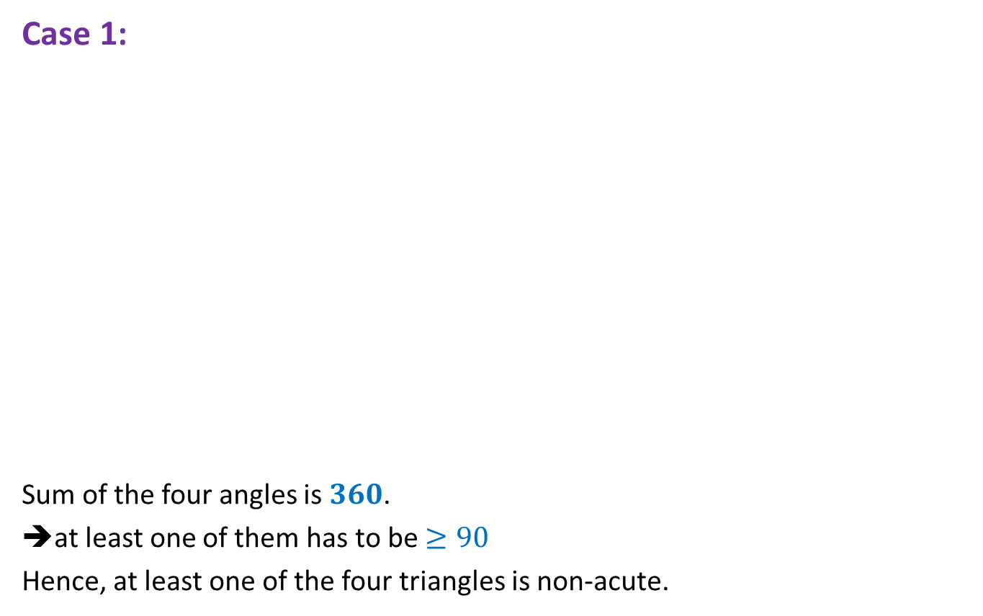

$4$ points
Case 1:
Sum of the four angles is $360$.
➔at least one of them has to be $≥90$
Hence, at least one of the four triangles is non-acute.

Slide 14
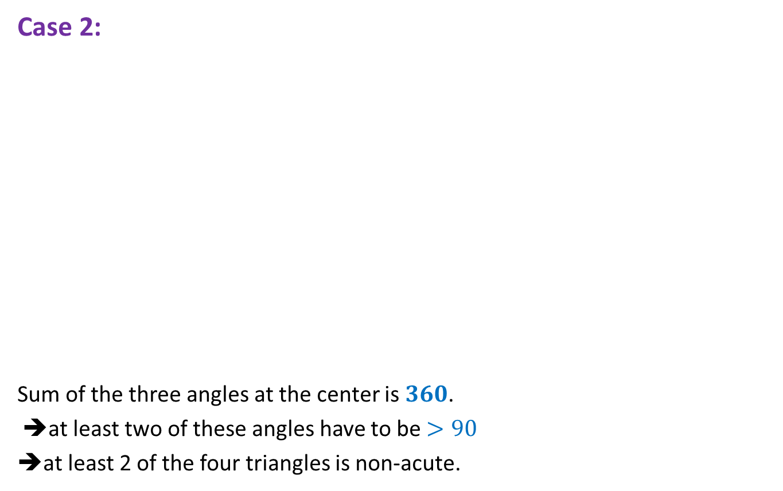
$4$ points
Case 2:
Sum of the three angles at the center is $360$.
➔at least two of these angles have to be $>90$
➔at least 2 of the four triangles is non-acute.

Slide 15

$4$ points ➔ $5$ points
Lemma1: A triangle formed by selecting 3 points randomly uniformly
from 4 points is acute triangle with probability at most $0.75$.
Lemma2: A triangle formed by selecting 3 points randomly uniformly
from 5 points is acute triangle with probability at most $0.7$.
Extension to 100 points ?
☹

Slide 16

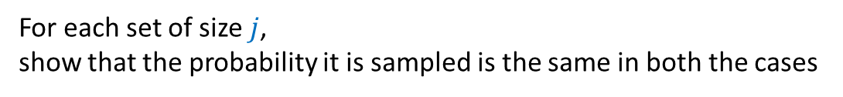








Two stage sampling
How to show this formally ?
$$j≤k≤n$$
$$R_{2}$$
$$j$$
?
Same probability distribution
$$R_{1}$$
$$k$$
$$R$$
$$j$$
$$S$$
$$n$$
$$S$$
$$n$$
Show that:
For each set of size $j$,
show that the probability it is sampled is the same in both the cases

Slide 17
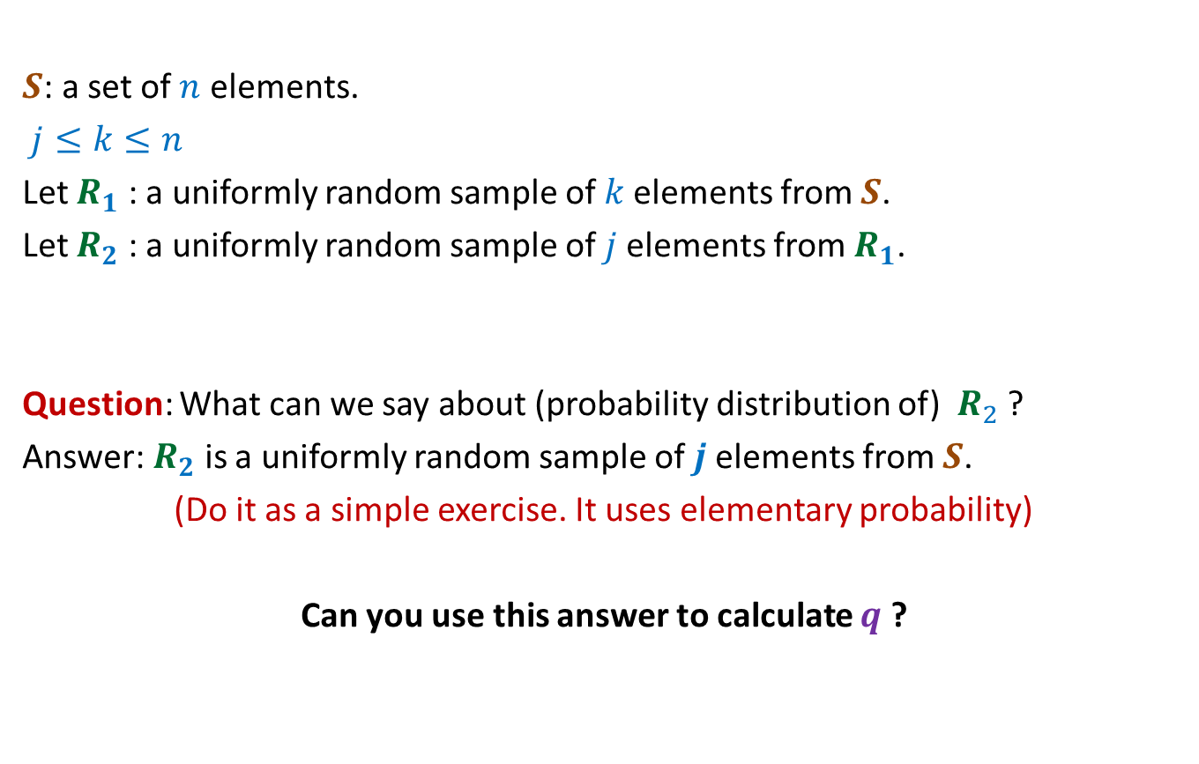
Two stage sampling
$S$: a set of $n$ elements.
$j≤k≤n$
Let $R_{1}$ : a uniformly random sample of $k$elements from $S$.
Let $R_{2}$ : a uniformly random sample of $j$elements from $R_{1}$.
Question: What can we say about (probability distribution of) $R_{2}$ ?
Answer: $R_{2}$ is a uniformly random sample of $j$elements from $S$.
(Do it as a simple exercise. It uses elementary probability)
Can you use this answer to calculate $q$ ?

Slide 18

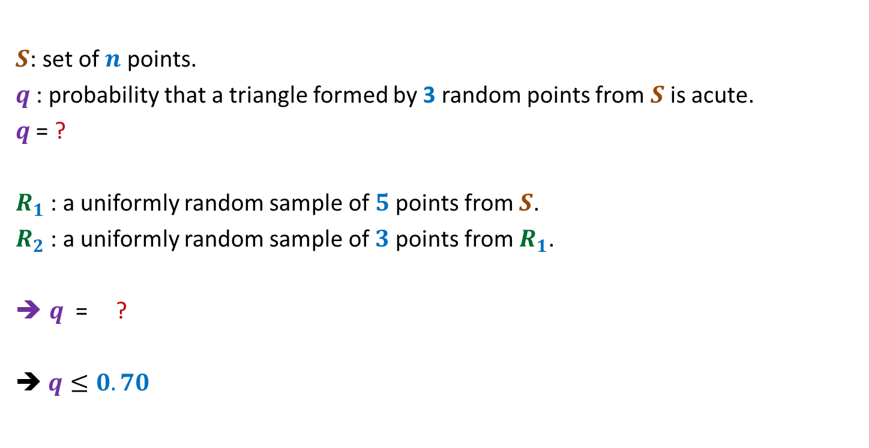


Number of acute triangles
$S$: set of $n$ points.
$q$ : probability that a triangle formed by 3 random points from $S$is acute.
$q$ = ?
$R_{1}$ : a uniformly random sample of $5$points from $S$.
$R_{2}$ : a uniformly random sample of $3$points from $R_{1}$.
$q$ = ?
➔ $q≤0.70$
P(a random triangle from $S$ is acute)
= P(a random triangle from $R_{2}$ is acute)
$$≤0.70$$

Slide 19
problem 3 Large CUT in a graph

Slide 20
Undirected graph

Slide 21
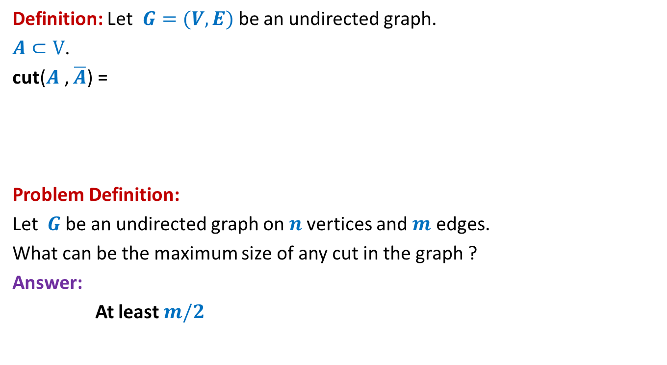
Large cut in a graph
Definition: Let $G=(V,E)$be an undirected graph.
$A⊂V$.
cut($A$, $\overline{A}$) =
Problem Definition:
Let $G$be an undirected graph on $n$vertices and $m$ edges.
What can be the maximum size of any cut in the graph ?
Answer:
At least $m/2$
{ $\left(u,v\right)∈E$) : $u∈A$, $v∈$ $\overline{A}$ or $u∈\overline{A}$, $v∈$ $A$}

Slide 22


Large cut in a graph
$$A$$
$$\overline{A}$$

Slide 23
Large cut in a graph
$$A$$
$$\overline{A}$$

Slide 24

Large cut in a graph
A randomized algorithm:
$A$←∅;
Add each vertex from $V$to $A$randomly independently with probability $\frac{1}{2}$.
Return the cut defined by $A$.

Slide 25

Large cut in a graph
$X$: size of cut ($A,\overline{A}$) returned by the randomized algorithm.
E[$X$] = ??
$$X_{e}:\left\{\begin{aligned}1 if e is present in the cut \\ 0 otherwise \end{aligned}\right.$$
$X=\sum_{e}{X_{e}}$
E[$X$] $=\sum_{e}{{E[X}_{e}]}$
$=\sum_{e}{{P(X}_{e}=1)}$

Slide 26









Large cut in a graph
$$A$$
$$\overline{A}$$
$$u$$
$$v$$
$$u$$
$$v$$
$$v$$
$$u$$
$$e$$
$$\frac{1}{4}$$
+
$$\frac{1}{4}$$

Slide 27

Large cut in a graph
$X$: size of cut ($A,\overline{A}$) returned by the randomized algorithm.
E[$X$] = ??
$$X_{e}:\left\{\begin{aligned}1 if e is present in the cut \\ 0 otherwise \end{aligned}\right.$$
$X=\sum_{e}{X_{e}}$
E[$X$] $=\sum_{e}{{E[X}_{e}]}$
$=\sum_{e}{{P(X}_{e}=1)}$
$=\sum_{e}{\frac{1}{2}}$
$=\frac{m}{2}$

Slide 28

Large cut in a graph
Using Fact 2,
there is a cut of size at least $\frac{m}{2}$ in every graph with $m$edges.

Slide 29
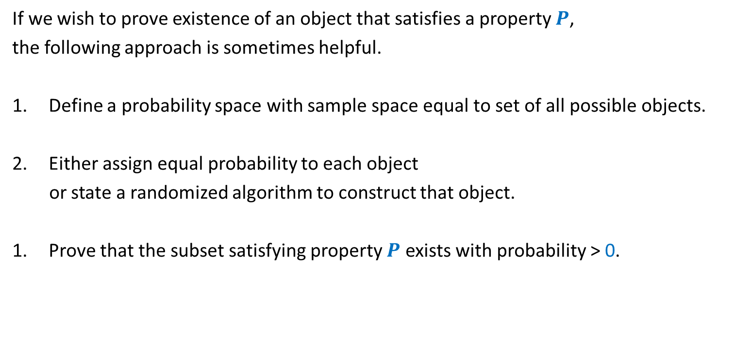
A common framework of using Probabilistic methods
If we wish to prove existence of an object that satisfies a property $P$,
the following approach is sometimes helpful.
Define a probability space with sample space equal to set of all possible objects.
Either assign equal probability to each object
or state a randomized algorithm to construct that object.
Prove that the subset satisfying property $P$ exists with probability > 0.

Slide 30



Questions from Discrete Mathematics
Question: (Geometry)
There is a set $P$of $100$points in plane and no three of them are collinear.
What can be the max. no. of acute triangles formed by these points ?
Theorem: (Large-cut)
Every graph on $n$vertices and $m$ edges has a cut of size $≥$ …..
At most $70\%$
Property:
Triangle is acute angle.
Sample space =
Set of all possible triangles formed by points from $P$.
Each triangle is equally likely to be picked.
We showed that a randomly picked triangle is acute angle triangle with probability $≤$ 0.7
We shall now demonstrate the use of this framework with a new problem ☺.
$$m/2$$
Property:
Cut of size $≥m/2$.
Sample space =
Set of all cuts (including cut defined by all vertices)
We gave a randomized algorithm to pick a cut.
We showed that expected size of the cut will be $≥m/2$

Slide 31

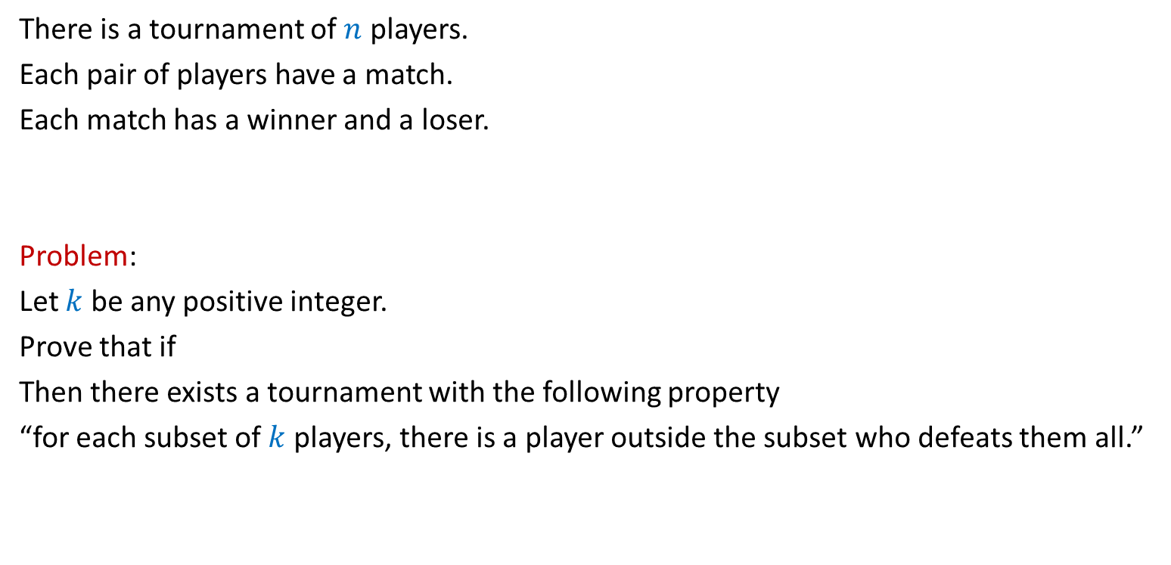
A problem
There is a tournament of $n$ players.
Each pair of players have a match.
Each match has a winner and a loser.
Problem:
Let $k$ be any positive integer.
Prove that if
Then there exists a tournament with the following property
“for each subset of $k$ players, there is a player outside the subset who defeats them all.”
$$\left({n \atop k}\right){\left(1−2^{−k}\right)}^{n−k}<1$$

Slide 32

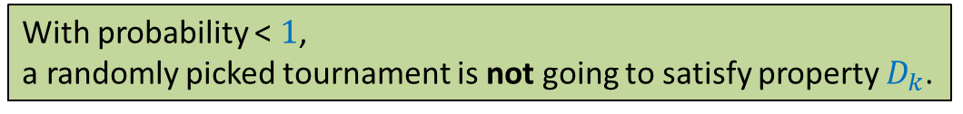



A problem
Problem: Let $k$ be any positive integer.
Prove that if
for each subset of $k$ players, there is a player outside the subset who defeats them all.
Let us use the framework described just now to solve this problem.
It suffices if we can show the following:
$$\left({n \atop k}\right){\left(1−2^{−k}\right)}^{n−k}<1$$
, then there exists a tournament of $n$players s.t.
Property $D_{k}$
Sample space =
Set of all possible tournaments
Size of the sample space = $2^{\left({n \atop 2}\right)}$
Each tournament is equally likely.
With probability < $1$,
a randomly picked tournament is not going to satisfy property $D_{k}$.

Slide 33
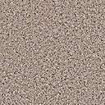


A problem
for each subset of $k$ players, there is a player outside the subset who defeats them all.
$$\left({n \atop k}\right){\left(1−2^{−k}\right)}^{n−k}<1$$
Property $D_{k}$
How to pick a tournament randomly ?
Assign winner of each match randomly uniformly
There are $\left({n \atop k}\right)$
Such subsets. So what is an upper bound on the probability that the tournament does not satisfy property $D_{k}$ ?
What is the probability that this player does not defeat all players of the set ?
What is the probability that this player defeats all players of the set ?
What is the probability that no player outside the set defeats all players of the set ?
Consider any player outside this set.
Consider any subset of $k$ players.
$$n−k$$
$$\left({n \atop k}\right)$$
$$2^{−k}$$
$$\left(1−2^{−k}\right)$$
$$<1$$
We are done ☺
$$k$$
Hint: Use Union theorem
$$n$$

Slide 34
problem 4 Sum Free subset

Slide 35
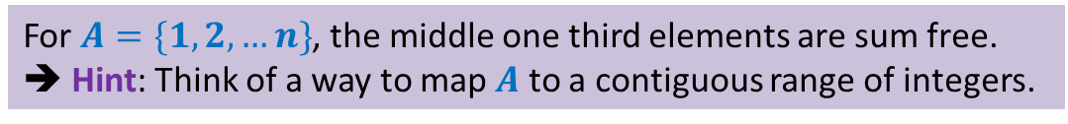
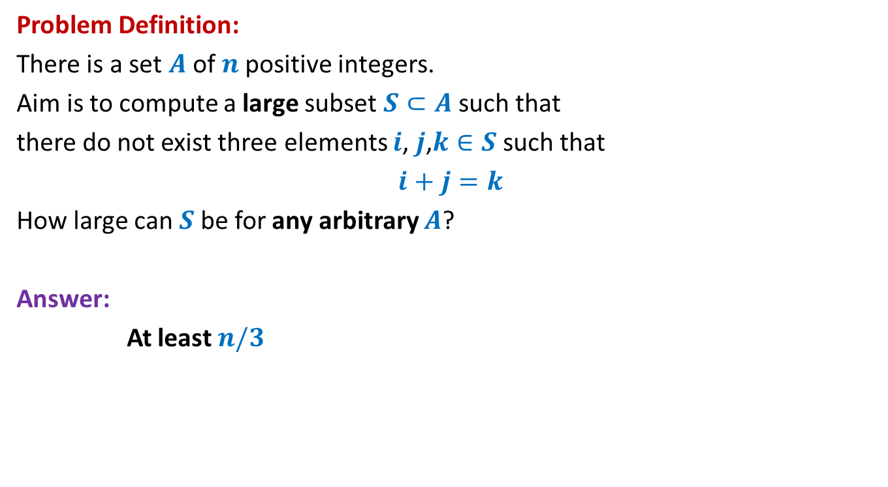
Large subset that is sum-free
Problem Definition:
There is a set $A$of $n$positive integers.
Aim is to compute a large subset $S⊂A$such that
there do not exist three elements $i$, $j$,$k∈S$ such that
$i+j=k$
How large can $S$be for any arbitrary $A$?
Answer:
At least $n/3$
We shall solve it in the next class. Please make sincere attempt to solve it.
For $A=\{1,2,…n\}$, the middle one third elements are sum free.
➔ Hint: Think of a way to map $A$ to a contiguous range of integers.

